Slide 1
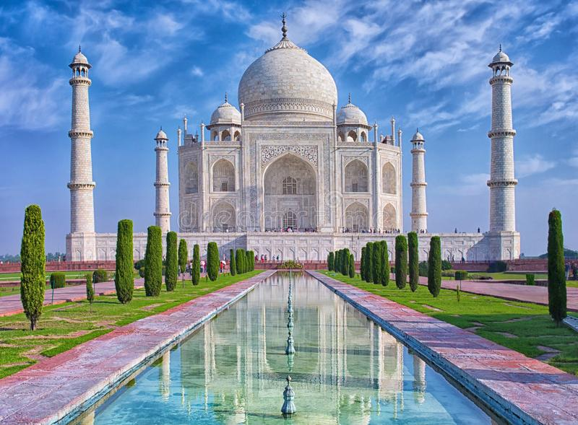
corrosion of taj mahal.
Iam k.shanmuka sai arun of class xa of siddhartha public school.

Slide 2
Contents :-
1) About history of taj mahal.
2) About acid rain .
3) Effects of acid rain on taj mahal.
4) Taj mahal before and after.
5) Causes of acid rain.
6) Measures to protect taj mahal from acid rain.

Slide 3
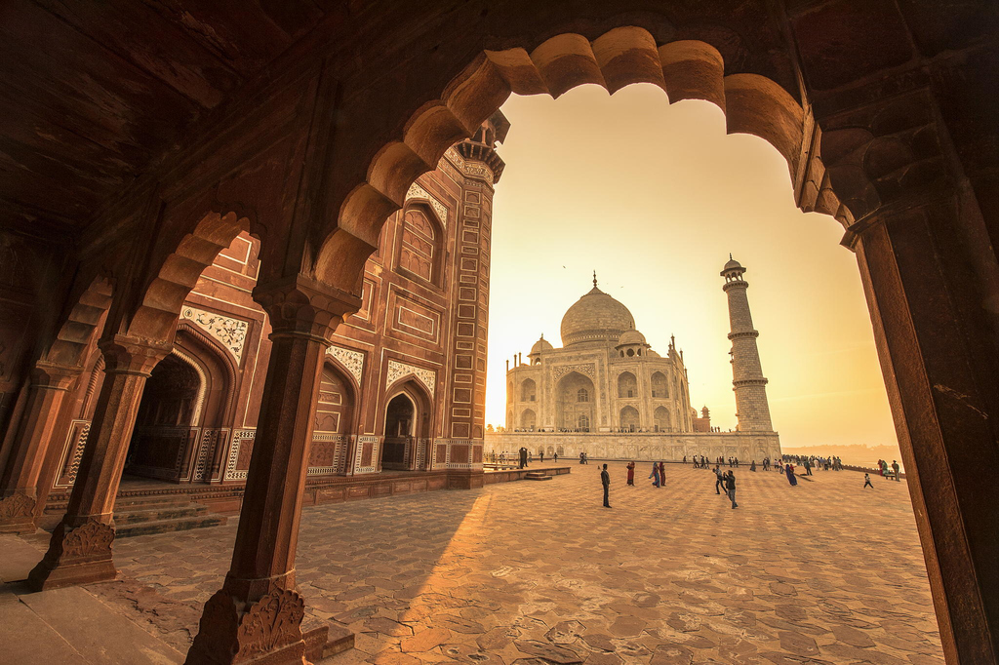
About history of taj mahal
The Taj Mahal is located on the right bank of the Yamuna River in a vast Mughal garden that encompasses nearly 17 hectares, in the Agra District in Uttar Pradesh. It was built by Mughal Emperor Shah Jahan in memory of his wife Mumtaz Mahal with construction starting in 1632 AD and completed in 1648 AD. For its construction, masons, stone-cutters, inlayers, carvers, painters, calligraphers, dome builders and other artisans were requisitioned from the whole of the empire and also from the Central Asia and Iran. Ustad-Ahmad Lahori was the main architect of the Taj Mahal.

Slide 4
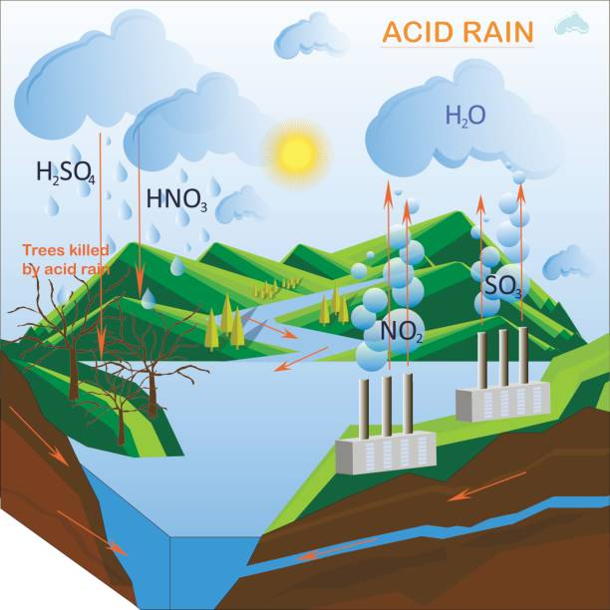
About acid rain
Acid rain is caused by a chemical reaction that begins when compounds like sulfur dioxide and nitrogen oxides are released into the air. These substances can rise very high into the atmosphere, where they mix and react with water, oxygen, and other chemicals to form more acidic pollutants, known as acid rain.

Slide 5
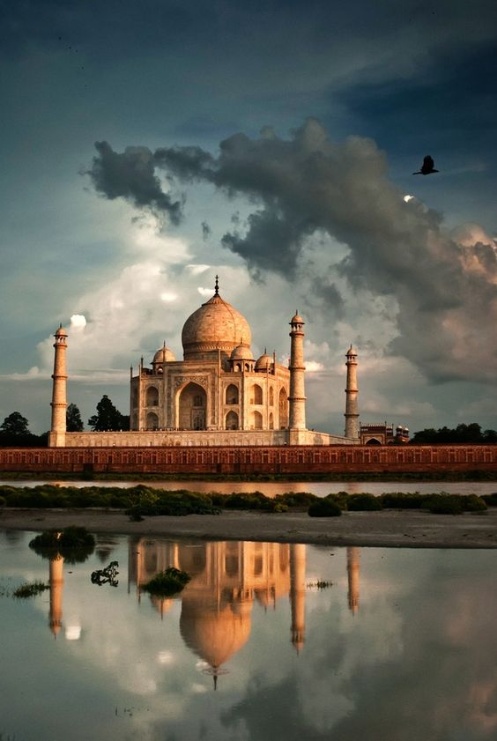
Effects of acid rain on taj mahal
When the acid rain attacks or falls on the Taj Mahal the monument gets corroded. Taj Mahal is completely made of marble, acid rains reacts with marble to form a powder-like substance which is then washed away by the rain. This phenomenon is called marble cancer.
In addition, the soot particles emitted from the Mathura oil refinery located near Agra is leading to the yellowing of Taj Mahal marble.

Slide 7
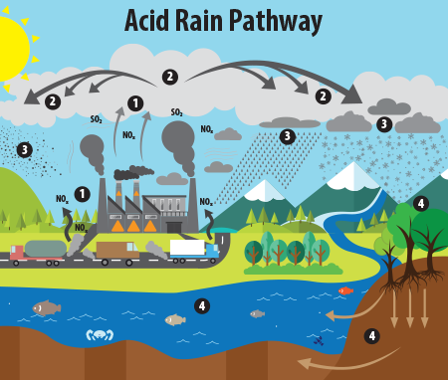
Causes of acid rain
Acid rain is caused by a chemical reaction that begins when compounds like sulfur dioxide and nitrogen oxides are released into the air. These substances can rise very high into the atmosphere, where they mix and react with water, oxygen, and other chemicals to form more acidic pollutants, known as acid rain.

Slide 8
Measures to protect taj mahal from acid rain :-
We need non-polluting industries in Agra. Waste management is a major issue in the city. Artificial illumination around the Taj Mahal is not a pollutant. Electric cremation has to be made compulsory. Clean up the sewage drain that has become the Yamuna.
Major desilting work of the river is required on an urgent basis.
We need non-polluting industries in Agra.

